Slide 1


Department of Computer Science and Engineering
Project work phase-II: Review-1 (15CSP85)
Stock market prediction using financial news articles
Batch No: CSE_2019_021 Group No:06
Kammavari Sangham (R) 1952, K.S.Group of Institutions
K. S INSTITUTE OF TECHNOLOGY, BENGALURU-560109
(Affiliated to VTU, Belagavi & Approved by AICTE, New Delhi, Accredited by NAAC & IEI)
Presented By:
Sampath Kumar
Shravan Bhat
Siddhanth M
Guided By:
Dr Rekha B Venkatapur
Professor, Dept of CSE,KSIT

Slide 2
CONTENTS
INTRODUCTION
COMPARISON WITH SIMILAR WORK
PROBLEM STATEMENT AND OBJECTIVES
METHODOLOGY PROPOSED
TECHNOLOGY USED
IMPLEMENTATION
SNAPSHOTS
REFERENCES

Slide 3
INTRODUCTION
Stock market prediction is the act of trying to determine the future value of a company stock or other financial instrument traded on an exchange.
The successful prediction of a stock's future price could yield significant profit.
Recent studies have shown that the vast amount of online information in the public domain such as news stories from the mainstream media, and social media discussions can have an observable effect on investors’ opinions towards financial markets.
Notes:
2 slides explaining stock market prediction and stock market prediction using financial news articles

Slide 4
PROBLEM STATEMENT AND OBJECTIVES
“To predict stock market movement using financial news articles”
Input: Stock market data along with live financial news article to predict the stock market movement.
Output: Expected movement(Prediction) of the specific shares of stock.
Objectives:
To help investors and stock market enthusiasts to have sufficient information in the stock market trends in order to make the right decision.
To provide a unified platform for viewing news from various sources.
To give real-time updates.

Slide 5
COMPARISON WITH SIMILAR WORK
YOP | AUTHOR | TITLE OF THE PAPER | DATASET | FEATURE PROCESSING METHODS | MACHINE LEARNING TECHNIQUES
2018 | Dev Shah, Haruna Isah, Farhana Zulkernine | Predicting the Effects of News Sentiments on the Stock Market | Moneycontrol, Investing.com | Dictionary based approach, sentiment analysis | NLP (n-gram model and stemming)
2017 | Yashwanth Singh Patel, Supriyo Mandal | Stock market prediction using daily news articles | www.kaggle.com/aaron7sun/stocknews, http://finance.yahoo.com | Stop word elimination, TF-IDF | NLP, MLP, LSTM
Notes:
SIMILAR WORK:
Yashwanth singh patel and surpriyo mandal
Dev Shah
Kaya
Huy D Hyunh
DICTIONARY BASED APPROACH, SENTIMENT ANALYSIS

Slide 6
YOP | AUTHOR | TITLE OF THE PAPER | DATASET | FEATURE PROCESSING METHODS | MACHINE LEARNING TECHNIQUES
2017 | Huy D Huynh | A new model for stock price movements prediction using deep neural network | S&P Stock index 500 | NA | LSTM, RNN, GRU
2010 | M.L Yaseef Kaya, M. Elif Karshgil | Stock price prediction using financial news articles | Microsoft Stock on NYSE | Chi-Square, Word couples | SVM, Data mining
Notes:
M.L YASEF KAYA, M. ELIF KARSHGIL
A New Model for Stock Price Movements Prediction Using Deep Neural Network

Slide 7
METHODOLOGY PROPOSED
The project is broken into 4 parts
PART I: Data collection and sentiment analysis on the collected data.
PART II: Training and running the ML model.
PART III: Calculating the performance of the model.
PART IV: Viewing of the prediction.

Slide 8
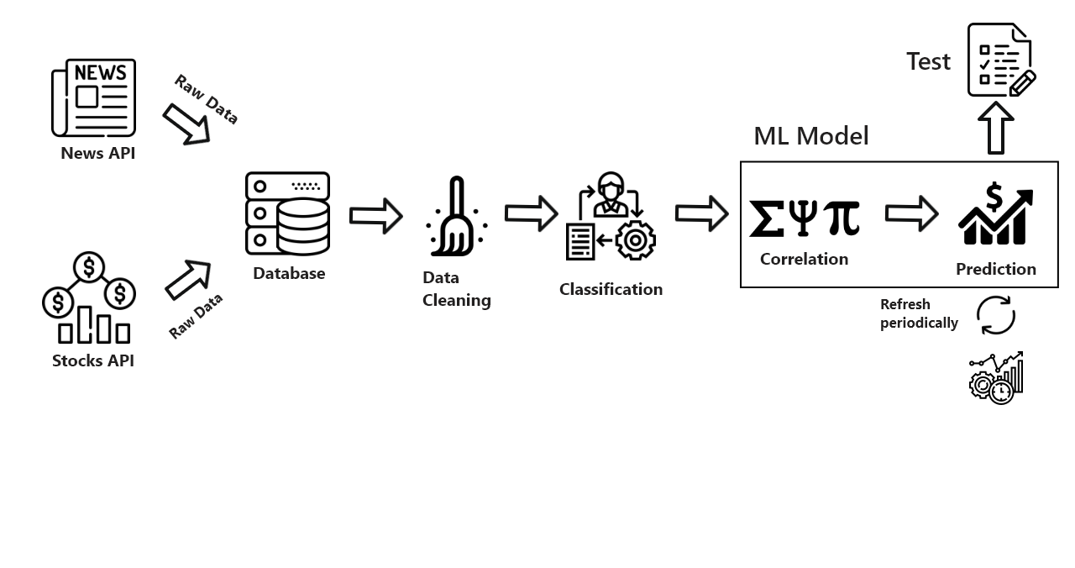
FLOW DIAGRAM

Slide 9
METHODOLOGY PROPOSED
PART I
Gathering of information
First step is to download the data from various news sources and their respective api’s.
Data is downloaded as well from the stock market indices and platforms with information like high, low, volume traded etc.
This scraping of information will be done with help of BeautifulSoup4 - A library in python for extracting data.

Slide 10
2. Cleaning the dataset
We will now parse the given information which has been downloaded, to process and remove any unnecessary information.
From the news articles, only the financial news will be loaded and any extra tags or information will be discarded.
The relevant fields from the stock market data will also be parsed in similar manner.
3. Determining the polarity of the news article
This is done by using the library Vader Analysis
The library goes through the article and assigns a value which is used in determining the polarity of the news article.
If the value is above 0, then it is considered as positive news
If the value is less than 0, then it is considered as a negative news

Slide 11
TECHNOLOGY USED
Languages used - Python, Javascript
API Backend - Flask
For collection of data from news websites -
BeautifulSoup4
Requests library
Vader analysis
Frontend -
ReactJS
CSS/HTML

Slide 12
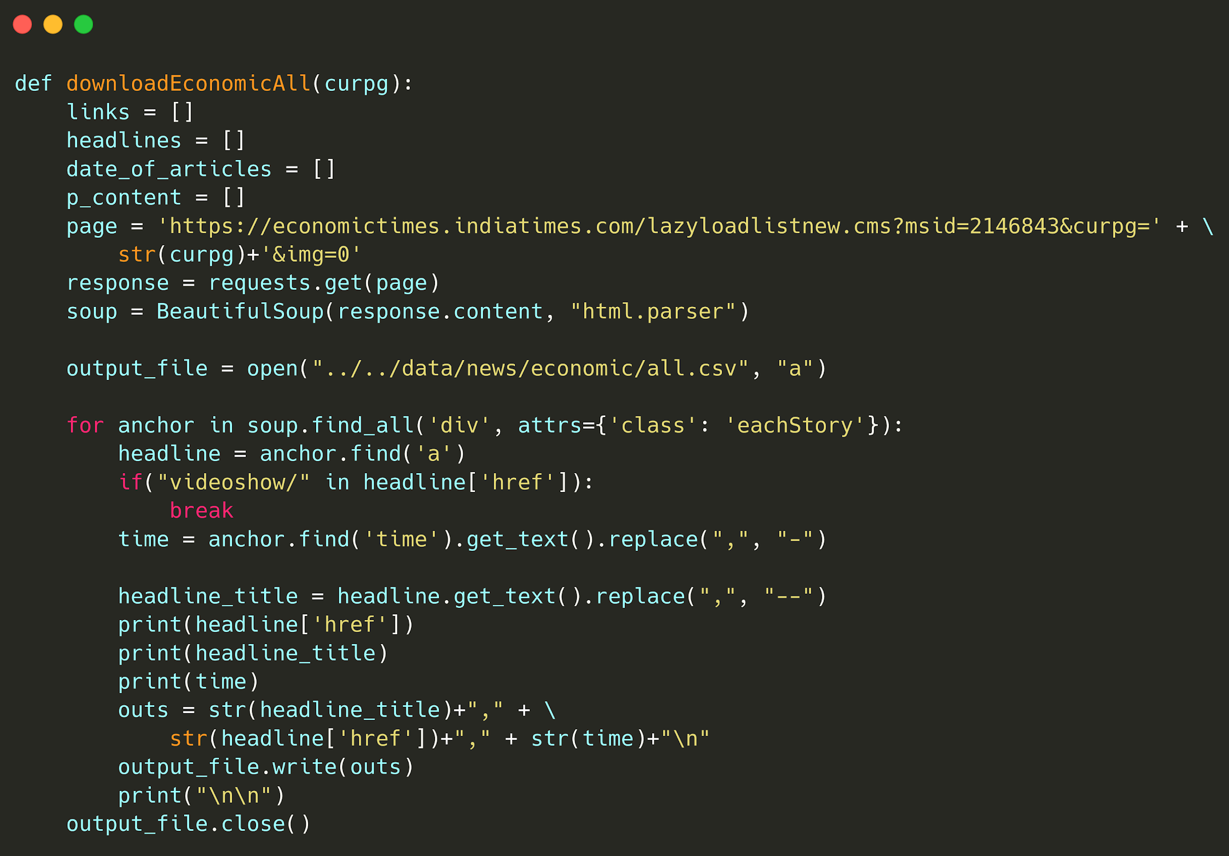
IMPLEMENTATION

Slide 13
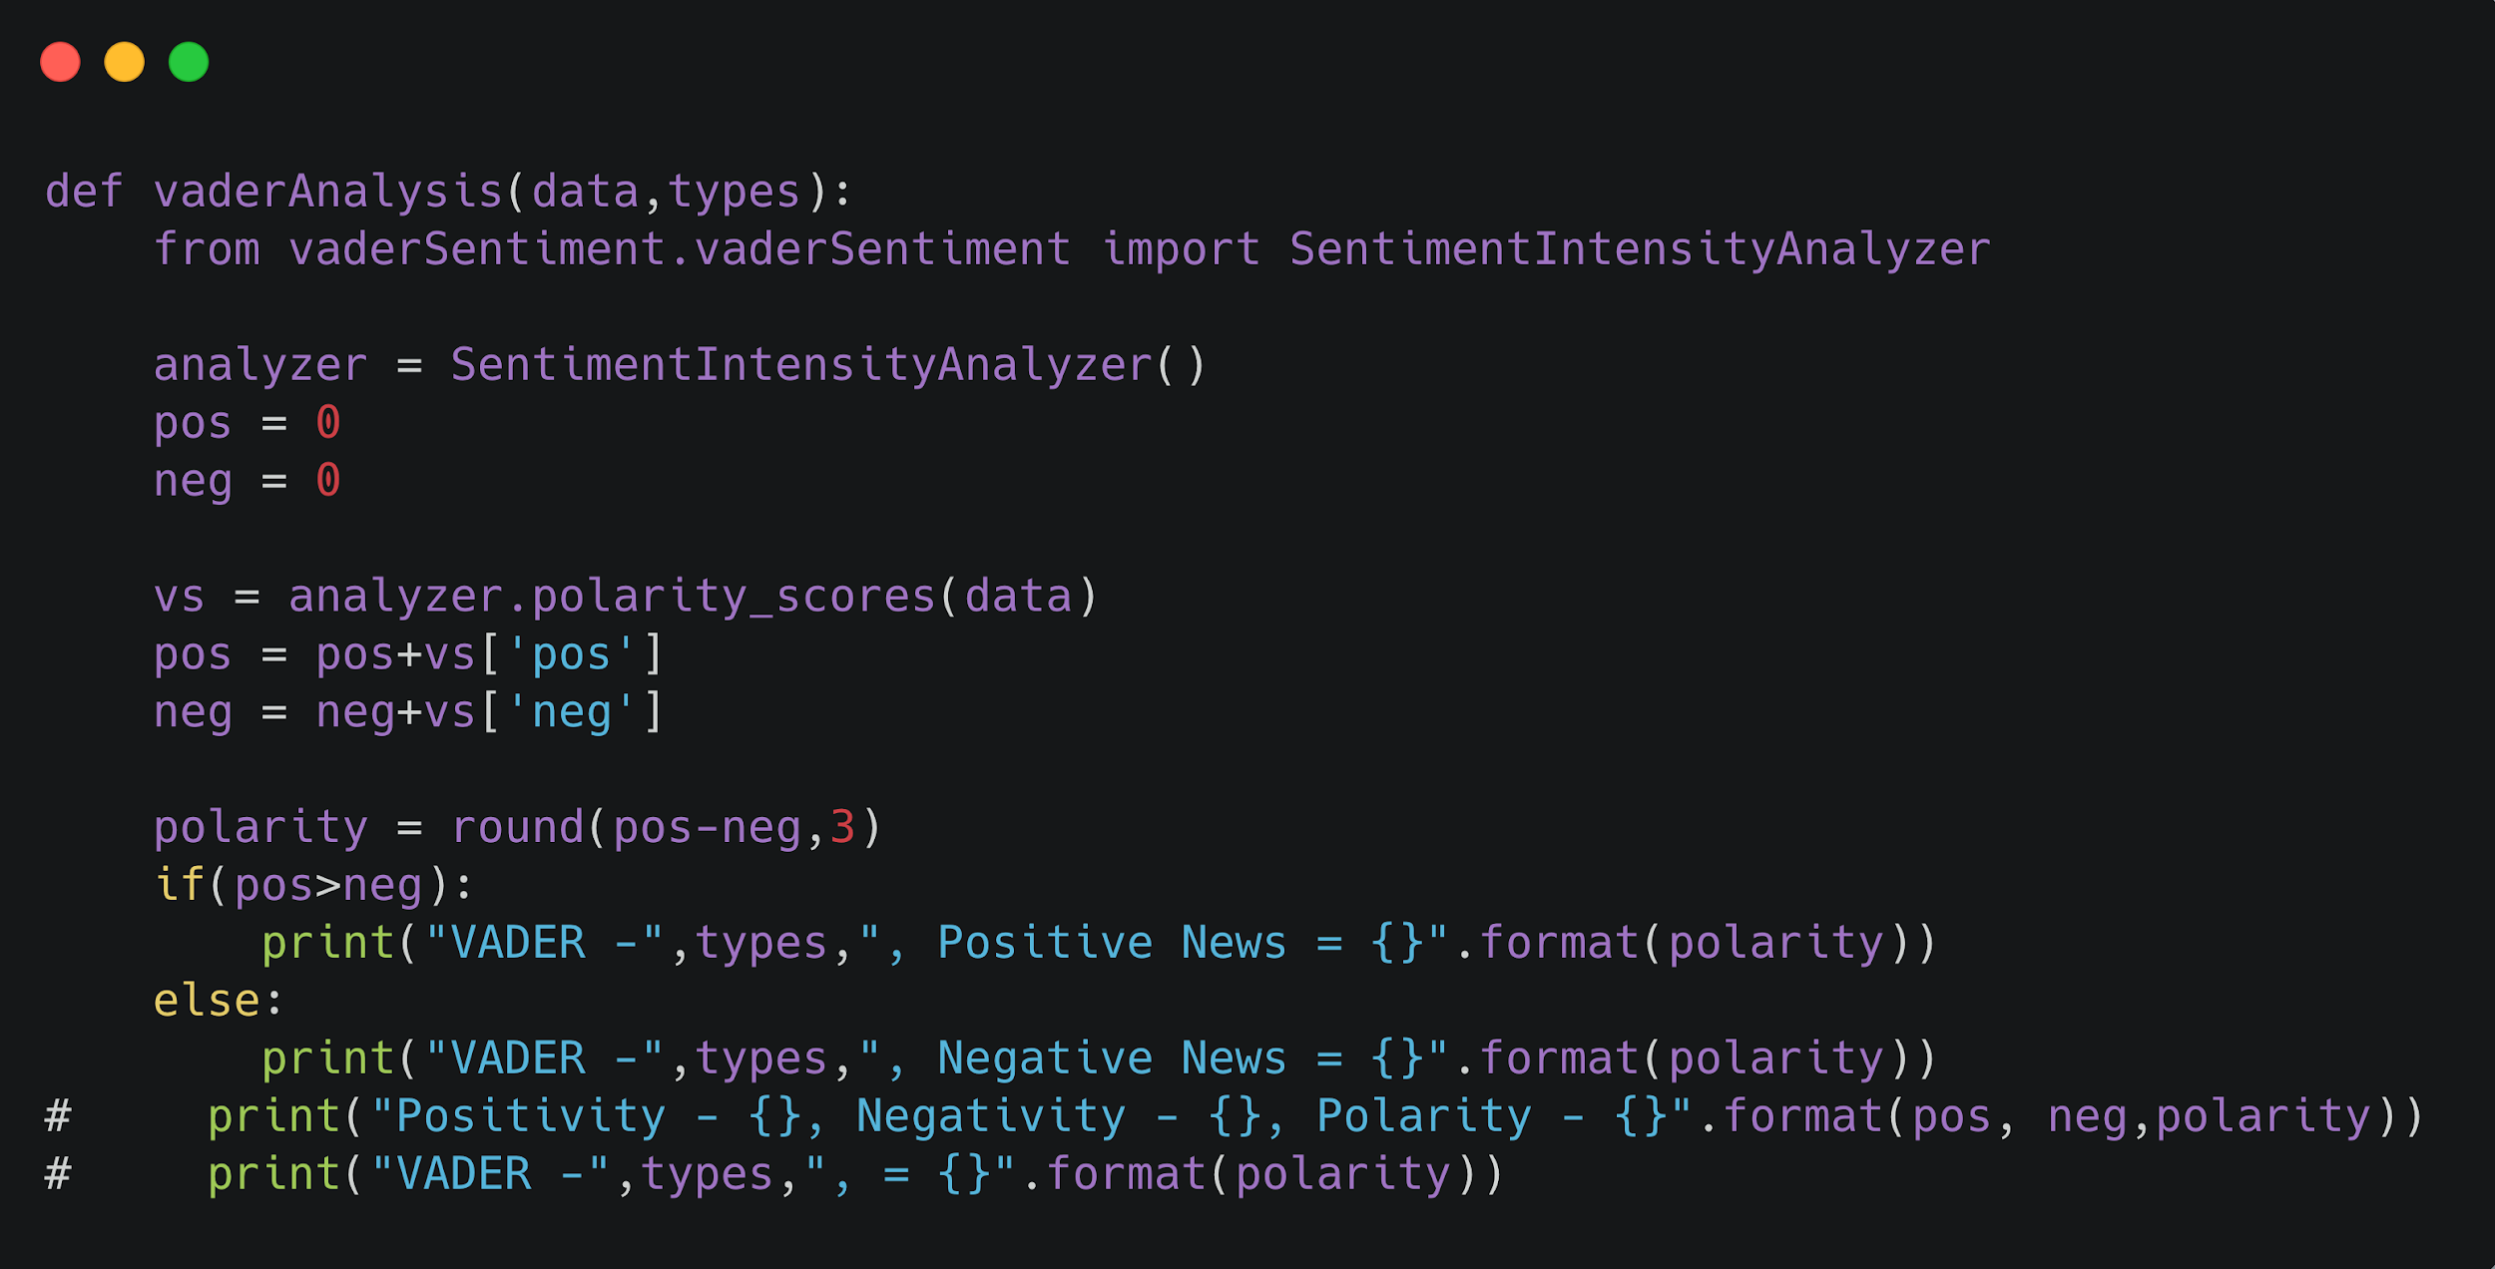

Slide 14
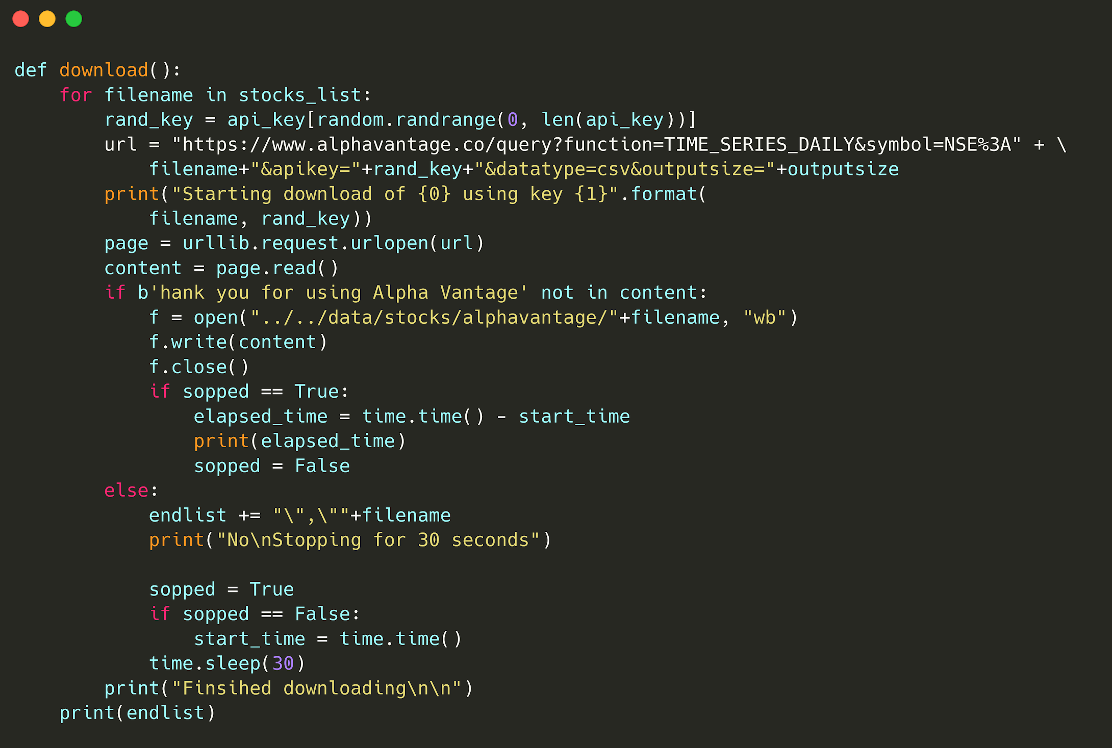

Slide 15
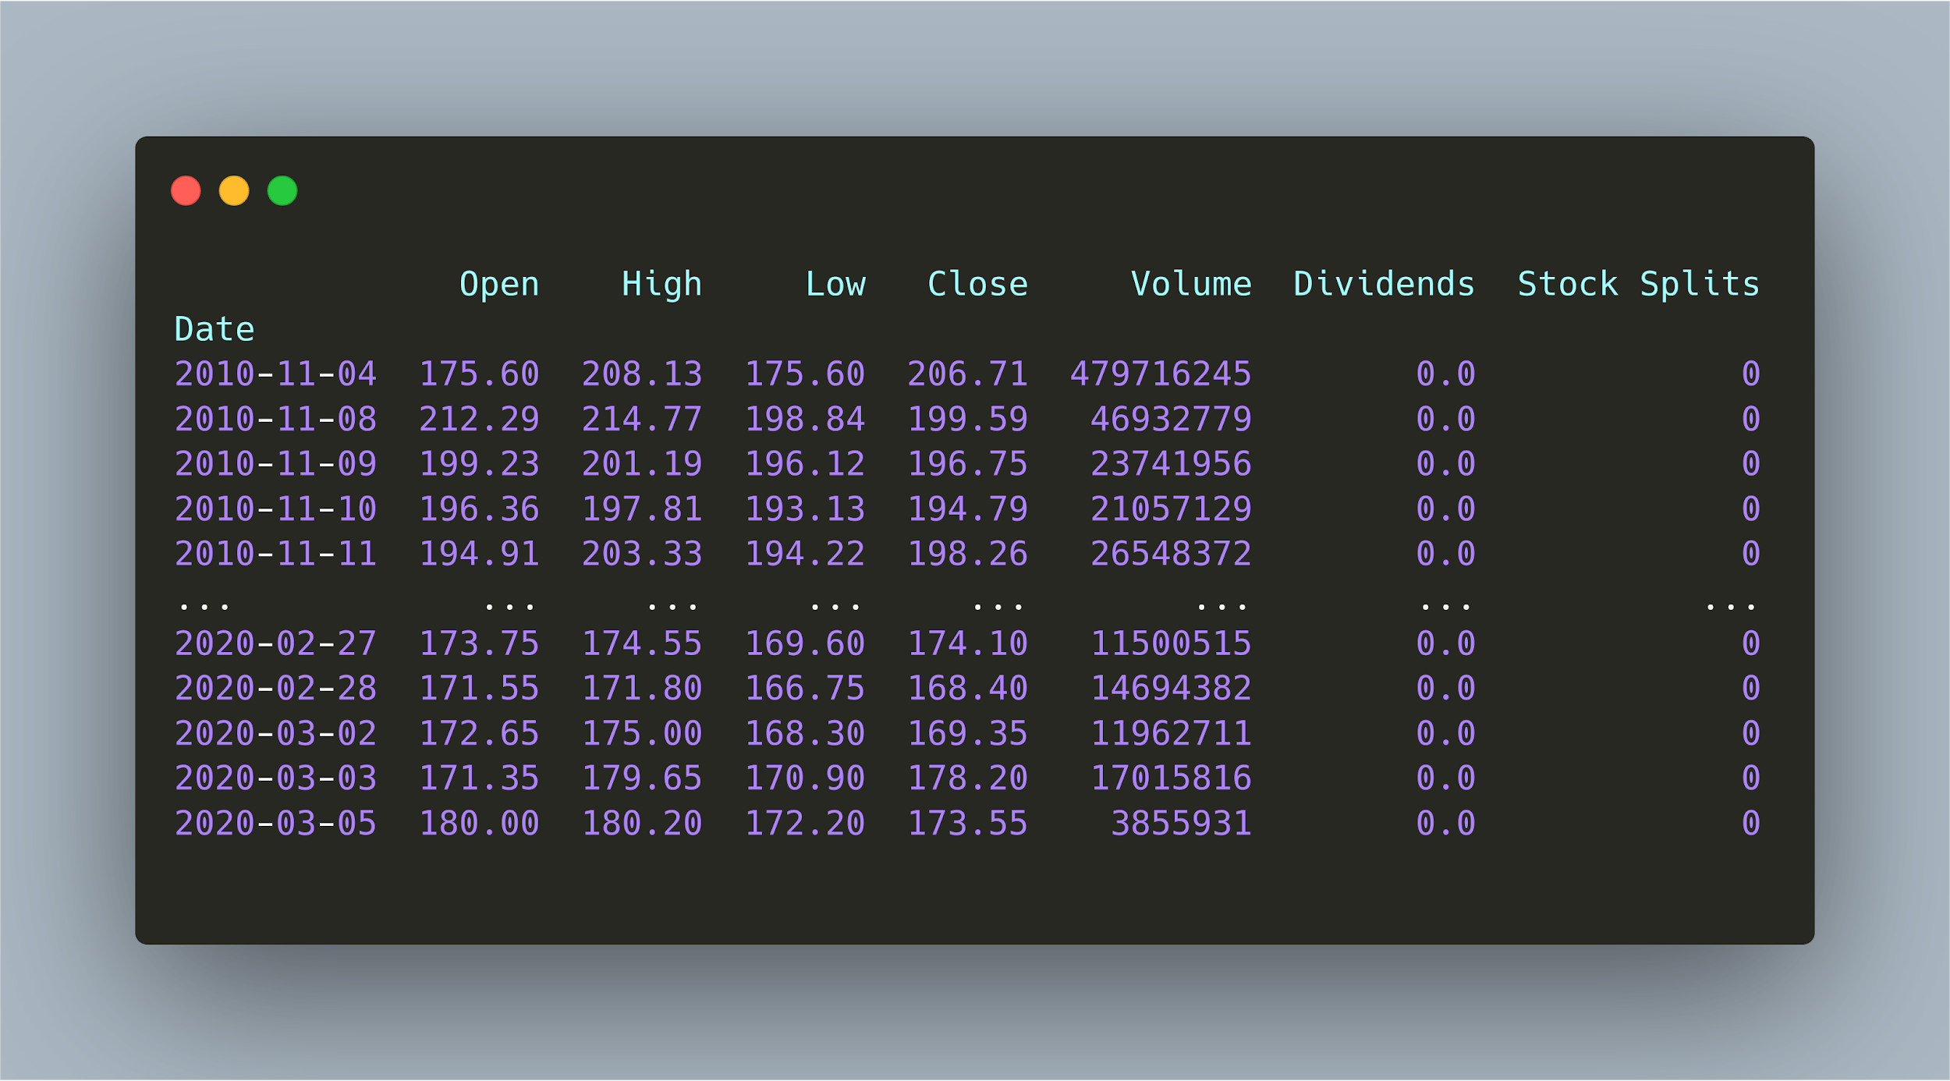
SNAPSHOTS

Slide 16
------
Headline - Antony Waste Handling Cell subscribed 16% on second day of bidding
VADER - Full , Positive News = 0.01, Neutral News = 0.849
AVERAGE SENTIMENT FOR PARAGRAPH: 0.0193
----------------------------------------------------
https://www.moneycontrol.com/news/business/ipo/antony-waste-handling-cell-subscribed-16-on-second-day-of-bidding-5006771.html
------
Headline - Wall Street tumbles as virus fears hit California, Dow Jones down over 2%
VADER - Full , Negative News = -0.085, Neutral News = 0.829
AVERAGE SENTIMENT FOR PARAGRAPH: -0.6264
----------------------------------------------------
https://www.moneycontrol.com/news/business/markets/wall-street-tumbles-as-virus-fears-hit-california-dow-jones-down-over-2-5007461.html
Headline - JP Morgan cuts YES Bank target to Re 1 after stake sale report
VADER - Full , Positive News = 0.014, Neutral News = 0.832
AVERAGE SENTIMENT FOR PARAGRAPH: -0.1431
----------------------------------------------------
https://www.moneycontrol.com/news/business/markets/jp-morgan-cuts-yes-bank-target-to-re-1-after-stake-sale-report-5006341.html

Slide 17
REFERENCES
[1] Dev Shah, Haruna Shah, Farhana Zulkernine, “Predicting the effects of news sentiments on the stock market,” 2018 IEEE conference on Big Data(Big Data), ISBN​:978-1-5386-5035-6/18 .
[2] Yasef Kaya, M. Elif Karsligil, “Stock price prediction using financial news articles”, 2010 IEEE , ISBN: 978-1-4244-6928-4/10.
[3] HD Huynh, LM Dang, D Duong, “A New model for stock price movements prediction using Deep Neural Network”, SoICT, 2017, pp.57-62: ACM
[4] Stock market prediction using daily news articles: Yashwanth Singh Patel, Supriyo Mandal, IIT Patna, 2017
[5] Cicil Fonseka, Liwan Liyanage, “A data mining algorithm to analyse stock market data using lagged correlation”, 2008 IEEE, ​ISBN:​ 978-1-4244-4/08.

Slide 18
REFERENCES
BeautifulSoup4 - https://www.crummy.com/software/BheautifulSoup/bs4/doc/
Vader Analysis-
https://www.geeksforgeeks.org/python-sentiment-analysis-using-vader/
Carbon.sh: https://carbon.sh
Kaggle: https://kaggle.com

Slide 19
THANK YOU!

Slide 20
